Slide 1

















































































Slide 2




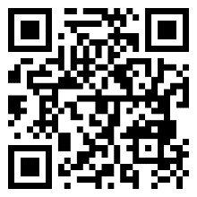

Date: 6-8pm, July 23, Friday
Venue: Zoom Webinar
Science is no illusion: extrafine combination therapy in asthma and COPD
18:00-18:10 | Opening | Dr Steve Yang | Dr Steve Yang
18:10-18:50 | Targeting the Sm(all) Airways in Asthma and Chronic Obstructive Pulmonary Disease | Dr. Mohd Arif Mohd Zim | Dr Steve Yang
18:50-19:30 | Optimization of COPD and ACOS patients treatment: from clinical trials to real-world evidence of extra-fine particle formulations | Dr Alvin Ng | Dr Steve Yang
19:30-20:00 | Panel Discussion & Closing Remark | Dr Steve Yang | Dr Steve Yang
Registration Link:
https://zoom.us/webinar/register/WN_vHPzwUZbSXW7u98uE6n4lQ
CME points pending for approval

